Slide 1
NVK SLIDE COLLECTIONS
NVK
16 NOVEMBER 2022

Slide 2

FORMATS
XML:
<CATALOG>
JSON:
{
"data":[
<CD>
{
<TITLE>Empire Burlesque</TITLE>
<ARTIST>Bob Dylan</ARTIST>
"type":"articles",
"id":"1",
"attributes":{
<COUNTRY>USA</COUNTRY>
"title":"JSON:API paints my bikeshed!",
<COMPANY>Columbia</COMPANY>
<PRICE>10.90</PRICE>
"body":"The shortest article. Ever.",
"created":"2015-05-22T14:56:29.000Z",
"updated":"2015-05-22T14:56:28.000Z"
<YEAR>1985</YEAR>
},
</CD>
<CD>
"relationships":{
"author":{
<TITLE>Hide your heart</TITLE>
"data":{
<ARTIST>Bonnie Tyler</ARTIST>
<COUNTRY>UK</COUNTRY>
"id":"42",
"type":"people"
}
<COMPANY>CBS Records</COMPANY>
}
<PRICE>9.90</PRICE>
<YEAR>1988</YEAR>
}
}
]
</CD>
}
</CATALOG>
NVK
16 NOVEMBER 2022

Slide 3
FRAMEWORK
Library: Like buying IKEA furniture, you need a new table, but don’t won’t to make it from scratch
Software: You decide where and how to use the library code
Framework: Like building a hose from a blueprint, where you have limited choices.
Software:
Control is moved to Framework (inversion of control)
Flow is therefore ‘dictacted’ from framework
NVK
16 NOVEMBER 2022

Slide 4
WHAT IS REST
Set of guiding principles that an Web API should adhere to to be an REST API
Architectural style (like 3 layer model)
NVK
16 NOVEMBER 2022

Slide 5
GUIDING PRINCIPLES
Uniform interface
Resource identification
Initial URL
Client-server
Separation of concern
Stateless
The server doesn’t hold any state
Cacheable
The client can save the response
Layered System
Only depended on the next immediate layer
Code on Demand (optional and not often used in practice)
Possibility to extend clients
NVK
16 NOVEMBER 2022

Slide 6
SECURITY
HTTPS
Always use HTTPs when creating Web API (And web pages in general)
API keys
Hide this key
OAUTH
NVK
16 NOVEMBER 2022

Slide 7
BUILDING REST
ASP.Net WebAPI
NVK
16 NOVEMBER 2022

Slide 8
DESIGNING REST API
Identify resources
Create URI
Determining representation
Assigning HTTP Verbs
NVK
16 NOVEMBER 2022

Slide 9
IDENTIFYING RESOURCES
Can typically be found in
Class Diagram
Entity Relationship Diagram
Should properly have an ID
NVK
16 NOVEMBER 2022

Slide 10
CREATING URIS
Should be nouns only
Resource normally in plural
And {id} to select specific
/patients vs /patients/{cpr}
Sub-collections can be specified in URL by specifying collection URL
/patients/{id}/observations
NVK
16 NOVEMBER 2022

Slide 11
RESOURCE REPRESENTATION
Either XML or JSON
Returning the most important data - especially when returning a collection
Returning a single resource
Include all data
Include relevant links
E.g. link to patients observations
/patients/1234567890/oberservations/123
/patients/1234567890/oberservations/180
/patients/1234567890/oberservations/231
NVK
16 NOVEMBER 2022

Slide 12
HTTP VERBS
Use GET to browse data
Big collections should have pagination
Browser secondary collection
/patients/123456789/observations
Use POST to create
Use PUT to update
Use DELETE to delete
Could be necessary to also use PUT to update (remove from) subcollections
NVK
16 NOVEMBER 2022

Slide 13
ASP.NET WEBAPI
Controllers in WebAPI should inherit from ControllerBase
You annotate each controller with [APIController] and [Route] [ApiController]
[Route("[controller]")]
public class WeatherForecastController : ControllerBase
Normal is one controller per resource
NVK
16 NOVEMBER 2022

Slide 14
HTTP ENDPOINTS
Each method in a Controller that is annotated with [HTTP*] will be ‘translated’ as an endpoint
[HttpPost]
public IActionResult CreatePatient(Patient patient) // or [HttpGet]
public IActionResult<List<Patient>> Get() // or [HttpGet]
[Route("Patients")]
public IActionResult<Patient> GetById(string id)
Using [FromBody], [FromQuery], etc parses parameters from either request body or parameters in URI.
NVK
16 NOVEMBER 2022

Slide 15
HATEOAS
Hypermedia A The Engine Of Application State
{
"departmentId": 10, "departmentName": "Administration", "locationId": 1700, "managerId": 200,
"links": [ {
"href": "10/employees", "rel": "employees",
"type" : "GET”
} ]
}
A dynamic way of navigating to related resources
Clients don’t need to be hard-coded
Don’t need to be in the body – could also be in the header
NVK
16 NOVEMBER 2022

Slide 16
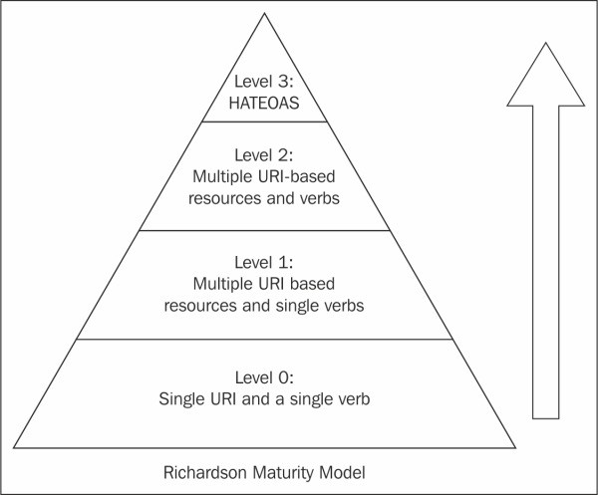
REST MATURITY LEVELS
Level 0:
Single word and single VERB
E.g. only a single http endpoint using post or get
Level 1:
Level 0, but with multiple resources
Level 2:
Multiple resources (endpoints) and uses different VERBs for CRUD operations
This you get from WebAPI if you use it like in the tutorial
Level 3:
Level 2 + HATEOAS
NVK
16 NOVEMBER 2022

Slide 17
IMPLEMENTING HETEOAS
Return type:
media type: application/hal+json media type: application/hal+xml
NVK
16 NOVEMBER 2022

Slide 18
DATA
public class Link
{
public string? Rel { get; set; } public string? HRef { get; set; }
}
public abstract class LinkedResource
{
public List<Link> Links { get; set; } public string HRef { get; set; }
}
NVK
16 NOVEMBER 2022

Slide 19
SETTING DATA
[HttpGet(Name = "GetAllPatients")] public IEnumerable<Patient> GetAll()
{
return PatientService.GetAll().Select(patient =>
{
Console.WriteLine(patient.Identifier.First().Value);
patient.Links = new List<Link>()
{
new()
{
Rel = "self",
HRef = Url.Link("GetPatientFromCpr", new { cpr = patient.Identifier.First().Value})
},
};
return patient;
});
}
NVK
16 NOVEMBER 2022

Slide 20
HL7 FHIR
NVK
16 NOVEMBER 2022

Slide 21
FHIR
Fast Healthcare Interoperability Resources
Consists of modular set of Resources
Usage
Mobile application, Cloud communication, EHR, …
Human and veterinary
Clinical care, public health, clinical trials, administration, financial
Built with web standards
XML and JSON
HTTP
Oauth
RESTfull architecture
NVK
16 NOVEMBER 2022

Slide 22
RESOURCES
Resource identity (ID) and Metadata
Human readable summary (XHTML)
Extensability URL -> definition
Handle local differences (due to law, practices etc.)
Standard data
NVK
16 NOVEMBER 2022

Slide 23
RESOURCE DESIGN
Designed for
Reuse and composability
Scalability
Performance
Usability
Data fidelity
Implementability
NVK
16 NOVEMBER 2022

Slide 24
RESOURCE ORGANIZATION
6 layers:
Foundation
Foundation resource – mostly (but not only) used for infrastructure and mostly (not only) referenced by other resources
Clinical
Covers most common use cases
Financial
Specialized
Less common use cases
Resource contextualization
Do not contain resources – used to ”extend, constrain and contextualize resources for a given purpose”
NVK
16 NOVEMBER 2022

Slide 25
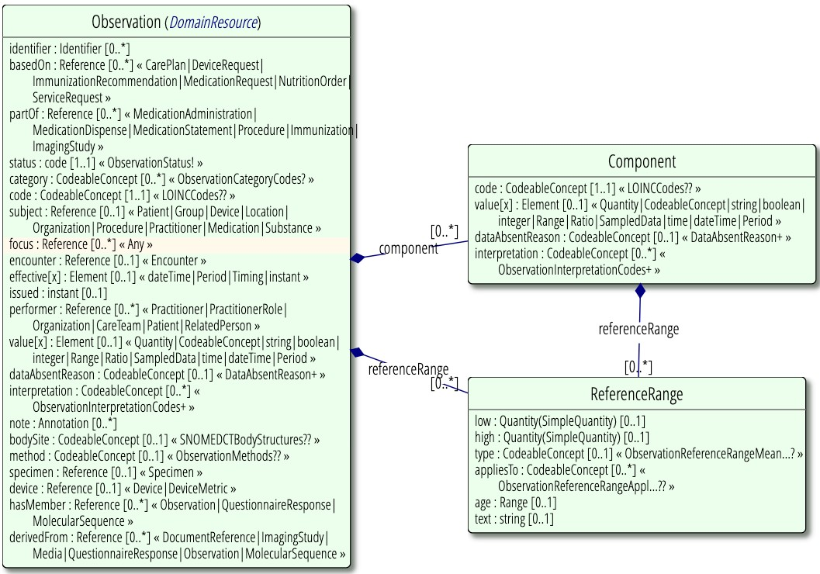
OBSERVATION
NVK
16 NOVEMBER 2022

Slide 26
AARHUS UNIVERSITY

